Slide 1
Harlem Renaissance
Mini-Unit
Jamie Schoenbauer

Slide 2
Topic Justification
https://docs.google.com/document/d/1k3ERq_XdvZCDXwv-0ka65pIkVsb2Bzyt6XqLfafXlXU/edit

Slide 3

Today’s Learning Target
We will be able to explain the social, cultural and political circumstances which gave rise to the Harlem Renaissance.

Slide 4
Community Builder - Quote Gallery Walk
Quotes are placed on the wall around the classroom. Each student has a tab. Leave the tab at the quote which resonates most with you today. Be prepared to explain why you chose the quote you did.
"Grab the broom of anger and drive off the beast of fear." - Zora Neale Hurston
“Hold fast to your dreams, for without them life is a broken winged bird that cannot fly.” - Langston Hughes
"I swear to the Lord, I still can't see, why Democracy means, everybody but me." - Langston Hughes
"The Negro must build on his own basis apart from the white man's foundation if he ever hopes to be a master builder." - Marcus Garvey
“There are years that ask questions and years that answer."- Zora Neale Hurston
"Freedom is never given; it is won." Asa Philip Randolph

Slide 5

Priming - Video Anticipation Guide/Vocabulary
Get blank paper.
Write anticipation “Harlem Renaissance” at the top. Use as many brown words as you can to predict what this video segment will be about:
Great Migration
Jazz
Racism
Stereotypes
Zoot Suit
Ethnic
Harlem
Composers
Using these words, write a sentence or two predicting what this video clip will be about. Share your sentence(s) with your neighbor.

Slide 6

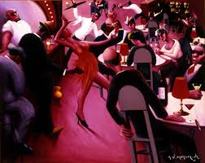
Watch: https://www.youtube.com/watch?v=90PTxdsqfsA&list=PLKJW0ok7H6lQHPC5G624zTyIaB4-ULcVp&index=139&t=0s
Then...
Look back at your original sentence. Is what you predicted correct?
Change your sentence(s) to make it more accurate. Use as many vocabulary words as you can.

Slide 7
Processing
Read “Harlem” by Walter Dean Myers to students and ask them to visualize the story as you are reading. As you read, you may show students a sideshow of Christopher Myers’ illustrations of the poem.
Give students a copy of the poem and ask them to underline all of the places and locations mentioned in it. Have students read the poem a third and final time and highlight or circle all of the people mentioned. Ask students why they think Harlem became a social and cultural center for African-Americans in the 1920s and 1930s.
Assign small groups to research some of the people and places. Once the research is complete, have students return to the large group and share their findings. Create bridge maps to show the relationships between the people and the places.

Slide 8
Retaining: Exit Slip
Pretend your friend was absent from class today and s/he asks you to explain the lesson. What would you tell him/her?

Slide 9
Today’s Learning Target
We will be able to read, discuss, and reflect on poems by Langston Hughes.

Slide 10
Community Builder
Alphabet Poetry Terms Taxonomy
Find other people with the same color rectangle as you.
Go to the Google doc: Alphabet Taxonomy Poetry Terms. https://docs.google.com/document/d/1c6JQ-u2n2rmdYDy9Cq0JzDOFBxGDb9d2syeeRVNf2WU/edit
Write down as many poetry terms as you can for each letter on the Taxonomy.
Share your list with another group.

Slide 11
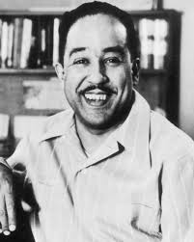
Bridging Back/Priming
https://newsela.com/read/bio-authors-langston-hughes/id/27280/write/
Complete the “Write” activity

Slide 12
Processing
Read, partner share short poems in which Langston Hughes expressed his dreams for America.
Dreams
I, Too, Sing America:
Safeshare video: The Great Debaters: https://safeshare.tv/x/ss5bde340c6886f#
Youtube video: https://www.youtube.com/watch?v=fNNMKJ1f9JM&index=141&list=PLKJW0ok7H6lQHPC5G624zTyIaB4-ULcVp&t=0s
Harlem (Dream Deferred)
Students choose the Hughes poem that spoke most vividly to them. Which poem painted the best image of the dreams that black people had for freedom and equality? Their choice depends only on what they felt as they read the poem. Do a close read of the poem looking for poetry terms from the taxonomy. Students should use a circle map to organize their material. Share in small groups.

Slide 13

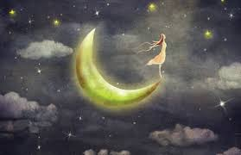
Retaining: Exit Slip
Post it note response: What’s your dream?

Slide 14
Today’s Learning Target
We will be able to understand the basics of the blues, see the influence of the blues in the work of poet Langston Hughes, and understand that there is musicality in poetry.

Slide 15
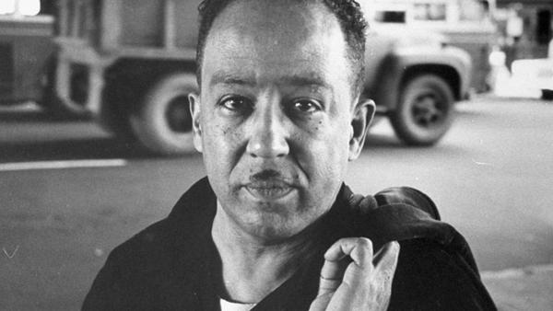
Community Builder
Cloze Method : Langston Hughes Poem

Slide 16
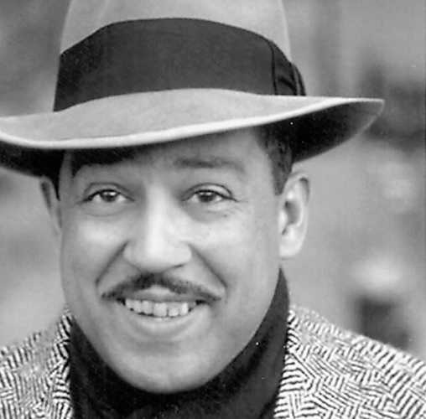
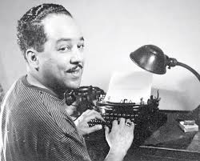
Bridging Back - Langston Hughes Speech Bubble
https://docs.google.com/presentation/d/1xMpXvjZkY5Z2xrhHfCyLzpi-mrF1hbg3iA_H7iLSaNg/edit#slide=id.g45a306c19d_0_116

Slide 17

Priming
Defining the blues
Discuss what it means to “have the blues.” When the students arrive at definitions, make a list of some of the things that give them the blues. Point out that these can be funny or silly things. Make a second class list of other words that could describe the blues (sad, disappointed, etc.). Tie into Top 20.

Slide 18

Listening to the music
Smithsonian Education: http://www.folkways.si.edu/explore_folkways/poetry.aspx
Play “The Story of the Blues,” a spoken-word recording in which Langston Hughes imagines a worker in a southern field creating the first blues song. Go to “Extended Audio” again and play a bit of “Good Morning Blues” by Lead Belly.
Read this stanza from Hughes’s poem “Morning After”:
I said, Baby! Baby!
Please don’t snore so loud.
Baby! Please!
Please don’t snore so loud.
You jest a little bit o’ woman but you
Sound like a great big crowd.
Ask the class if they notice similarities between the poem and the song. If they need prompting, call attention to what Hughes said about the verse structure of the blues.

Slide 19
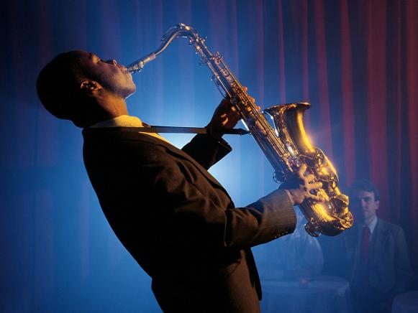
Composing and performing a blues poem
Everyone will take a few minutes to compose his or her own three-line blues. As shown in Hughes’s Snoring Blues, the subject of the poem—the complaint—need not be a mournful cry from the heart. A poem called “Homework Blues,” for example, would be a valid contribution to the form. As would “Composing a Three-Line Blues Blues.”
Listen again to the beat of “Good Morning Blues” (da-DUM, da-DUM, da-DUM, da-DUM). Students can clap along or tap on their desks until they get the hang of the beat.
Students present poems.

Slide 20

Retaining: Exit Slip
Emoji Exit Slip

