Slide 1
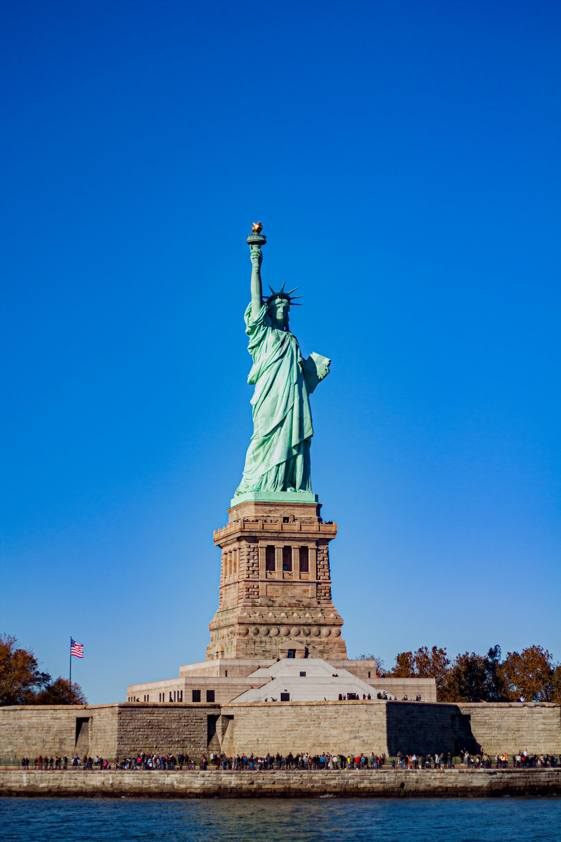
The Statue of Liberty

Slide 2
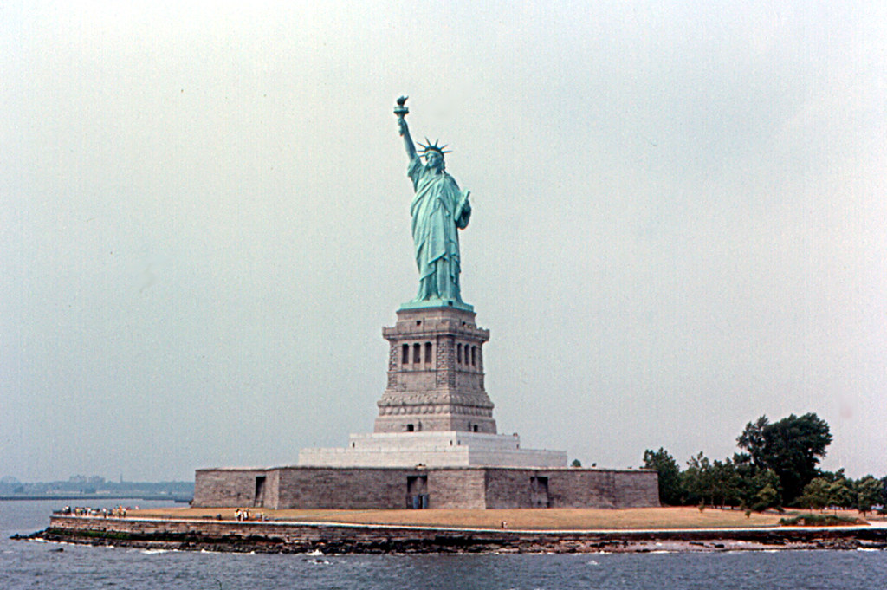
Lady Liberty was unveiled in 1886.
This Photo by Unknown Author is licensed under CC BY-SA

Slide 3
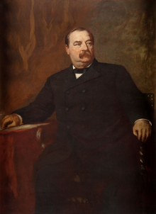

She was dedicated by U.S. President Grover Cleveland on Oct. 28, 1886.
This Photo by Unknown Author is licensed under CC BY-SA

Slide 4
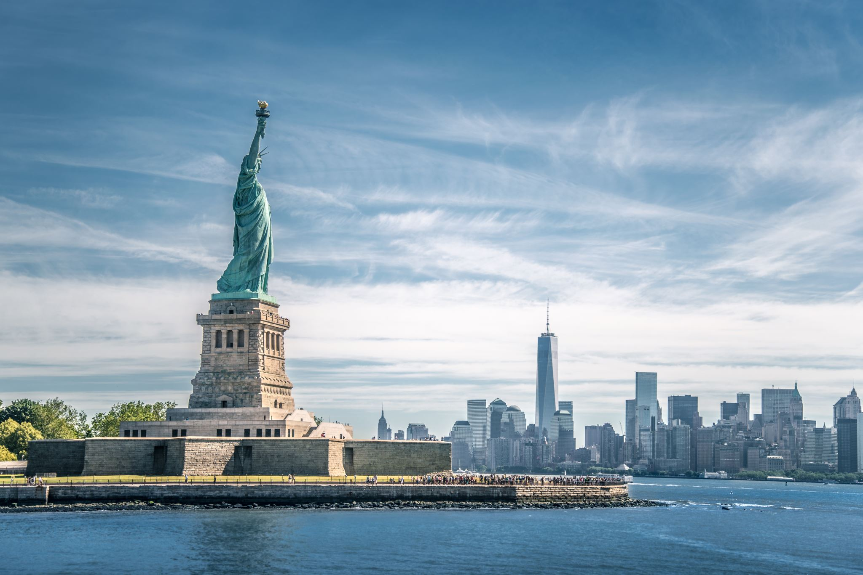

She is located in New York Harbor on
Ellis Island.

Slide 5
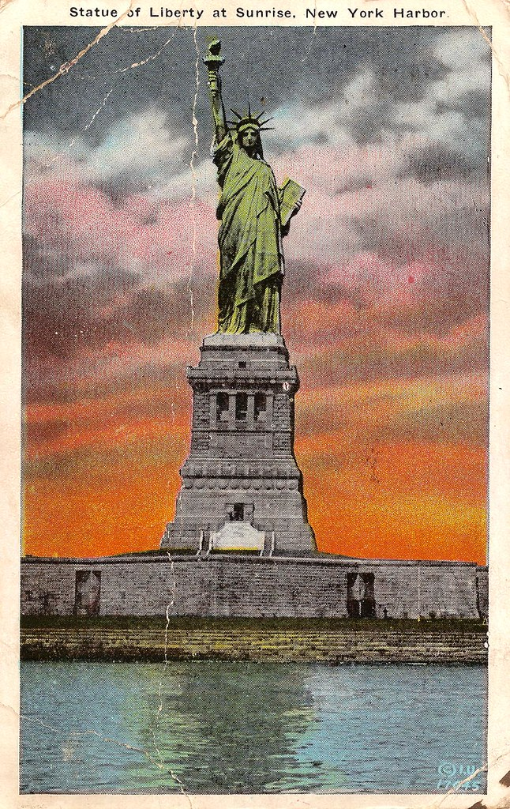
She has greeted thousands of immigrants and visitors as they entered New York Bay and arrived in the United States.
This Photo by Unknown Author is licensed under CC BY

Slide 6
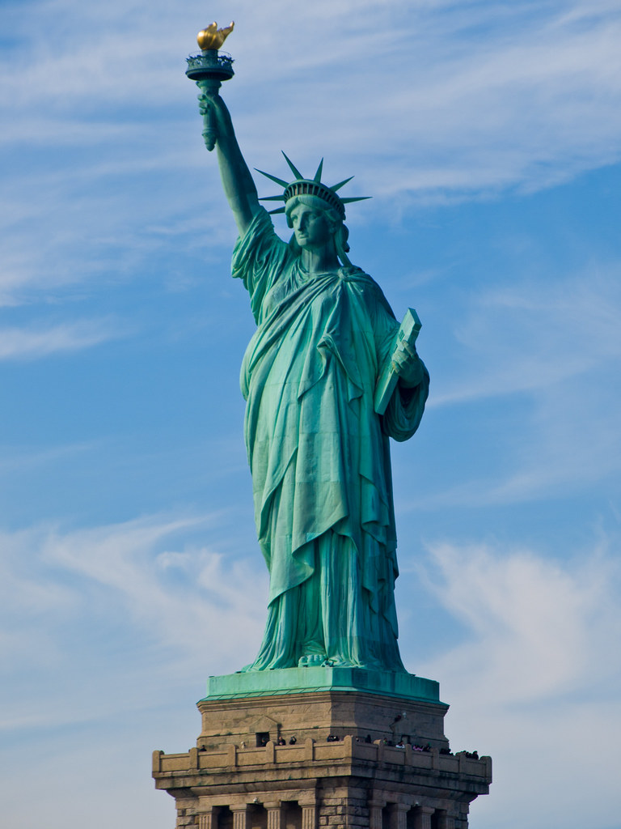
The Statue of Liberty is 46 m (151 ft). The surface of the statue is composed of hammered copper sheets 2.4 mm (0.01 in) thick that are riveted to an iron framework.
This Photo by Unknown Author is licensed under CC BY

Slide 7
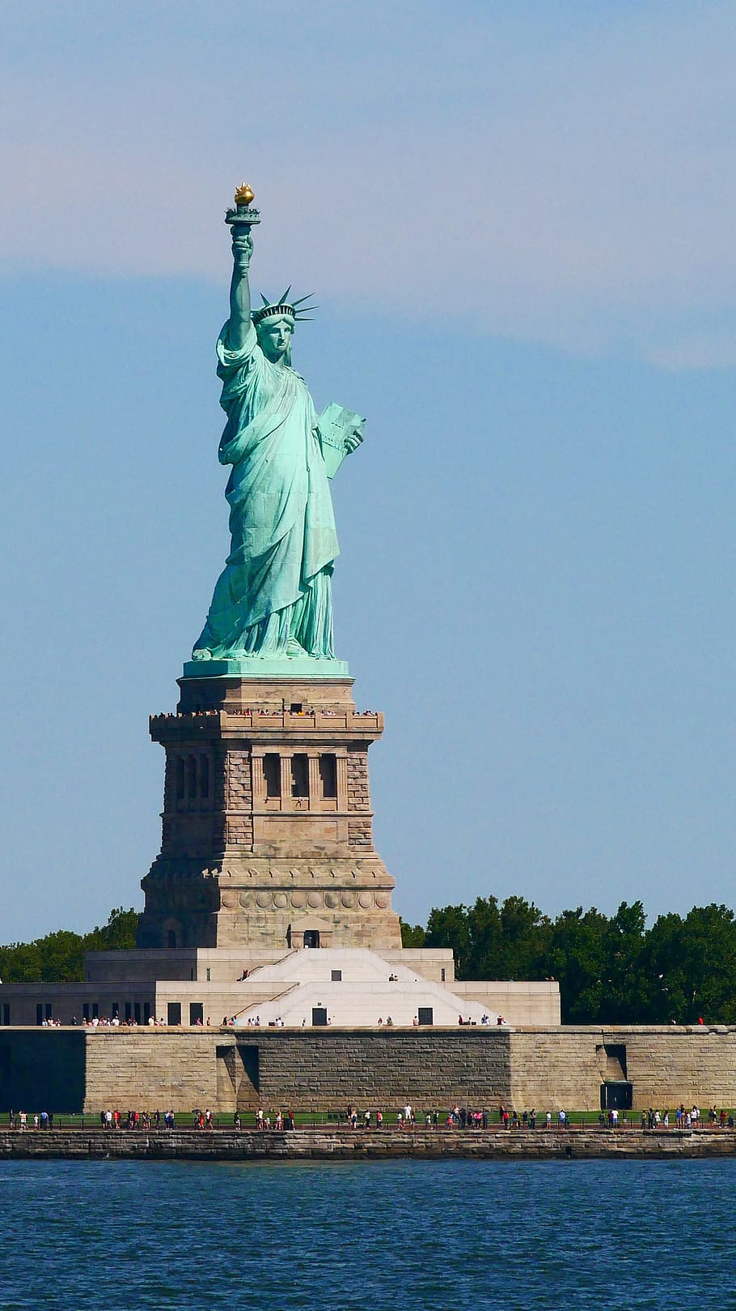
The statue rests upon a concrete-and-granite pedestal. Its base and pedestal increase the height of the monument to 93m (305 ft).

Slide 8
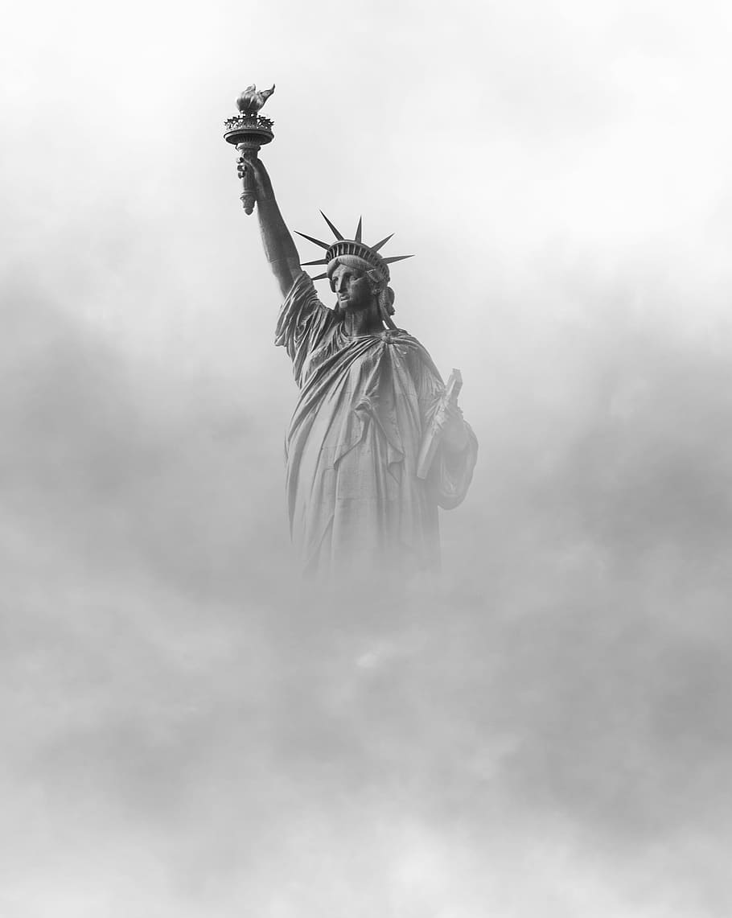
The Statue of Liberty is a monumental sculpture that symbolizes freedom throughout the world. Its formal name is Liberty Enlightening the World.

Slide 9
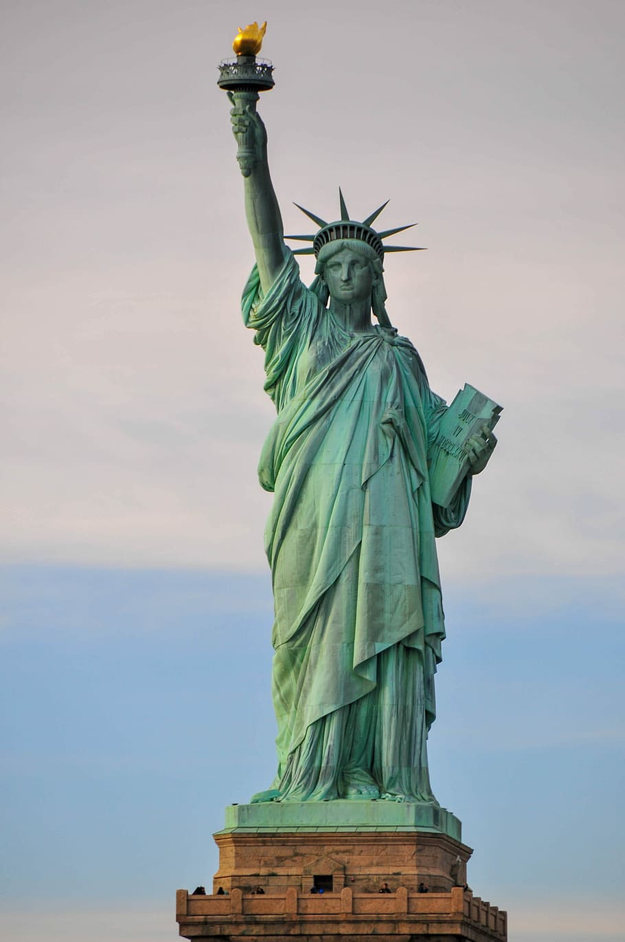
The statue depicts a woman escaping the chains of tyranny, which lie at her feet. Her right hand holds aloft a burning torch that represents liberty.

Slide 10
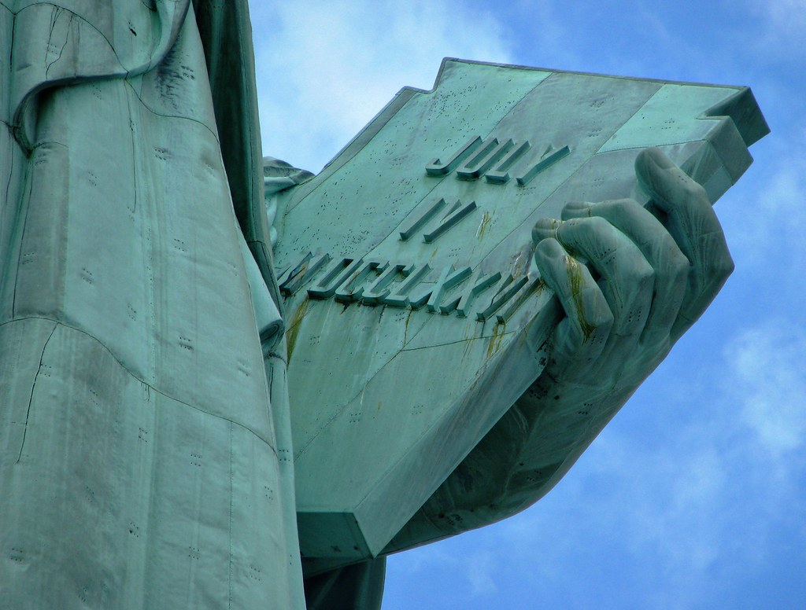
Her left hand holds a tablet inscribed with the date “July 4, 1776” in Roman Numerals, the day the United States declared its independence.
This Photo by Unknown Author is licensed under CC BY-NC

Slide 11
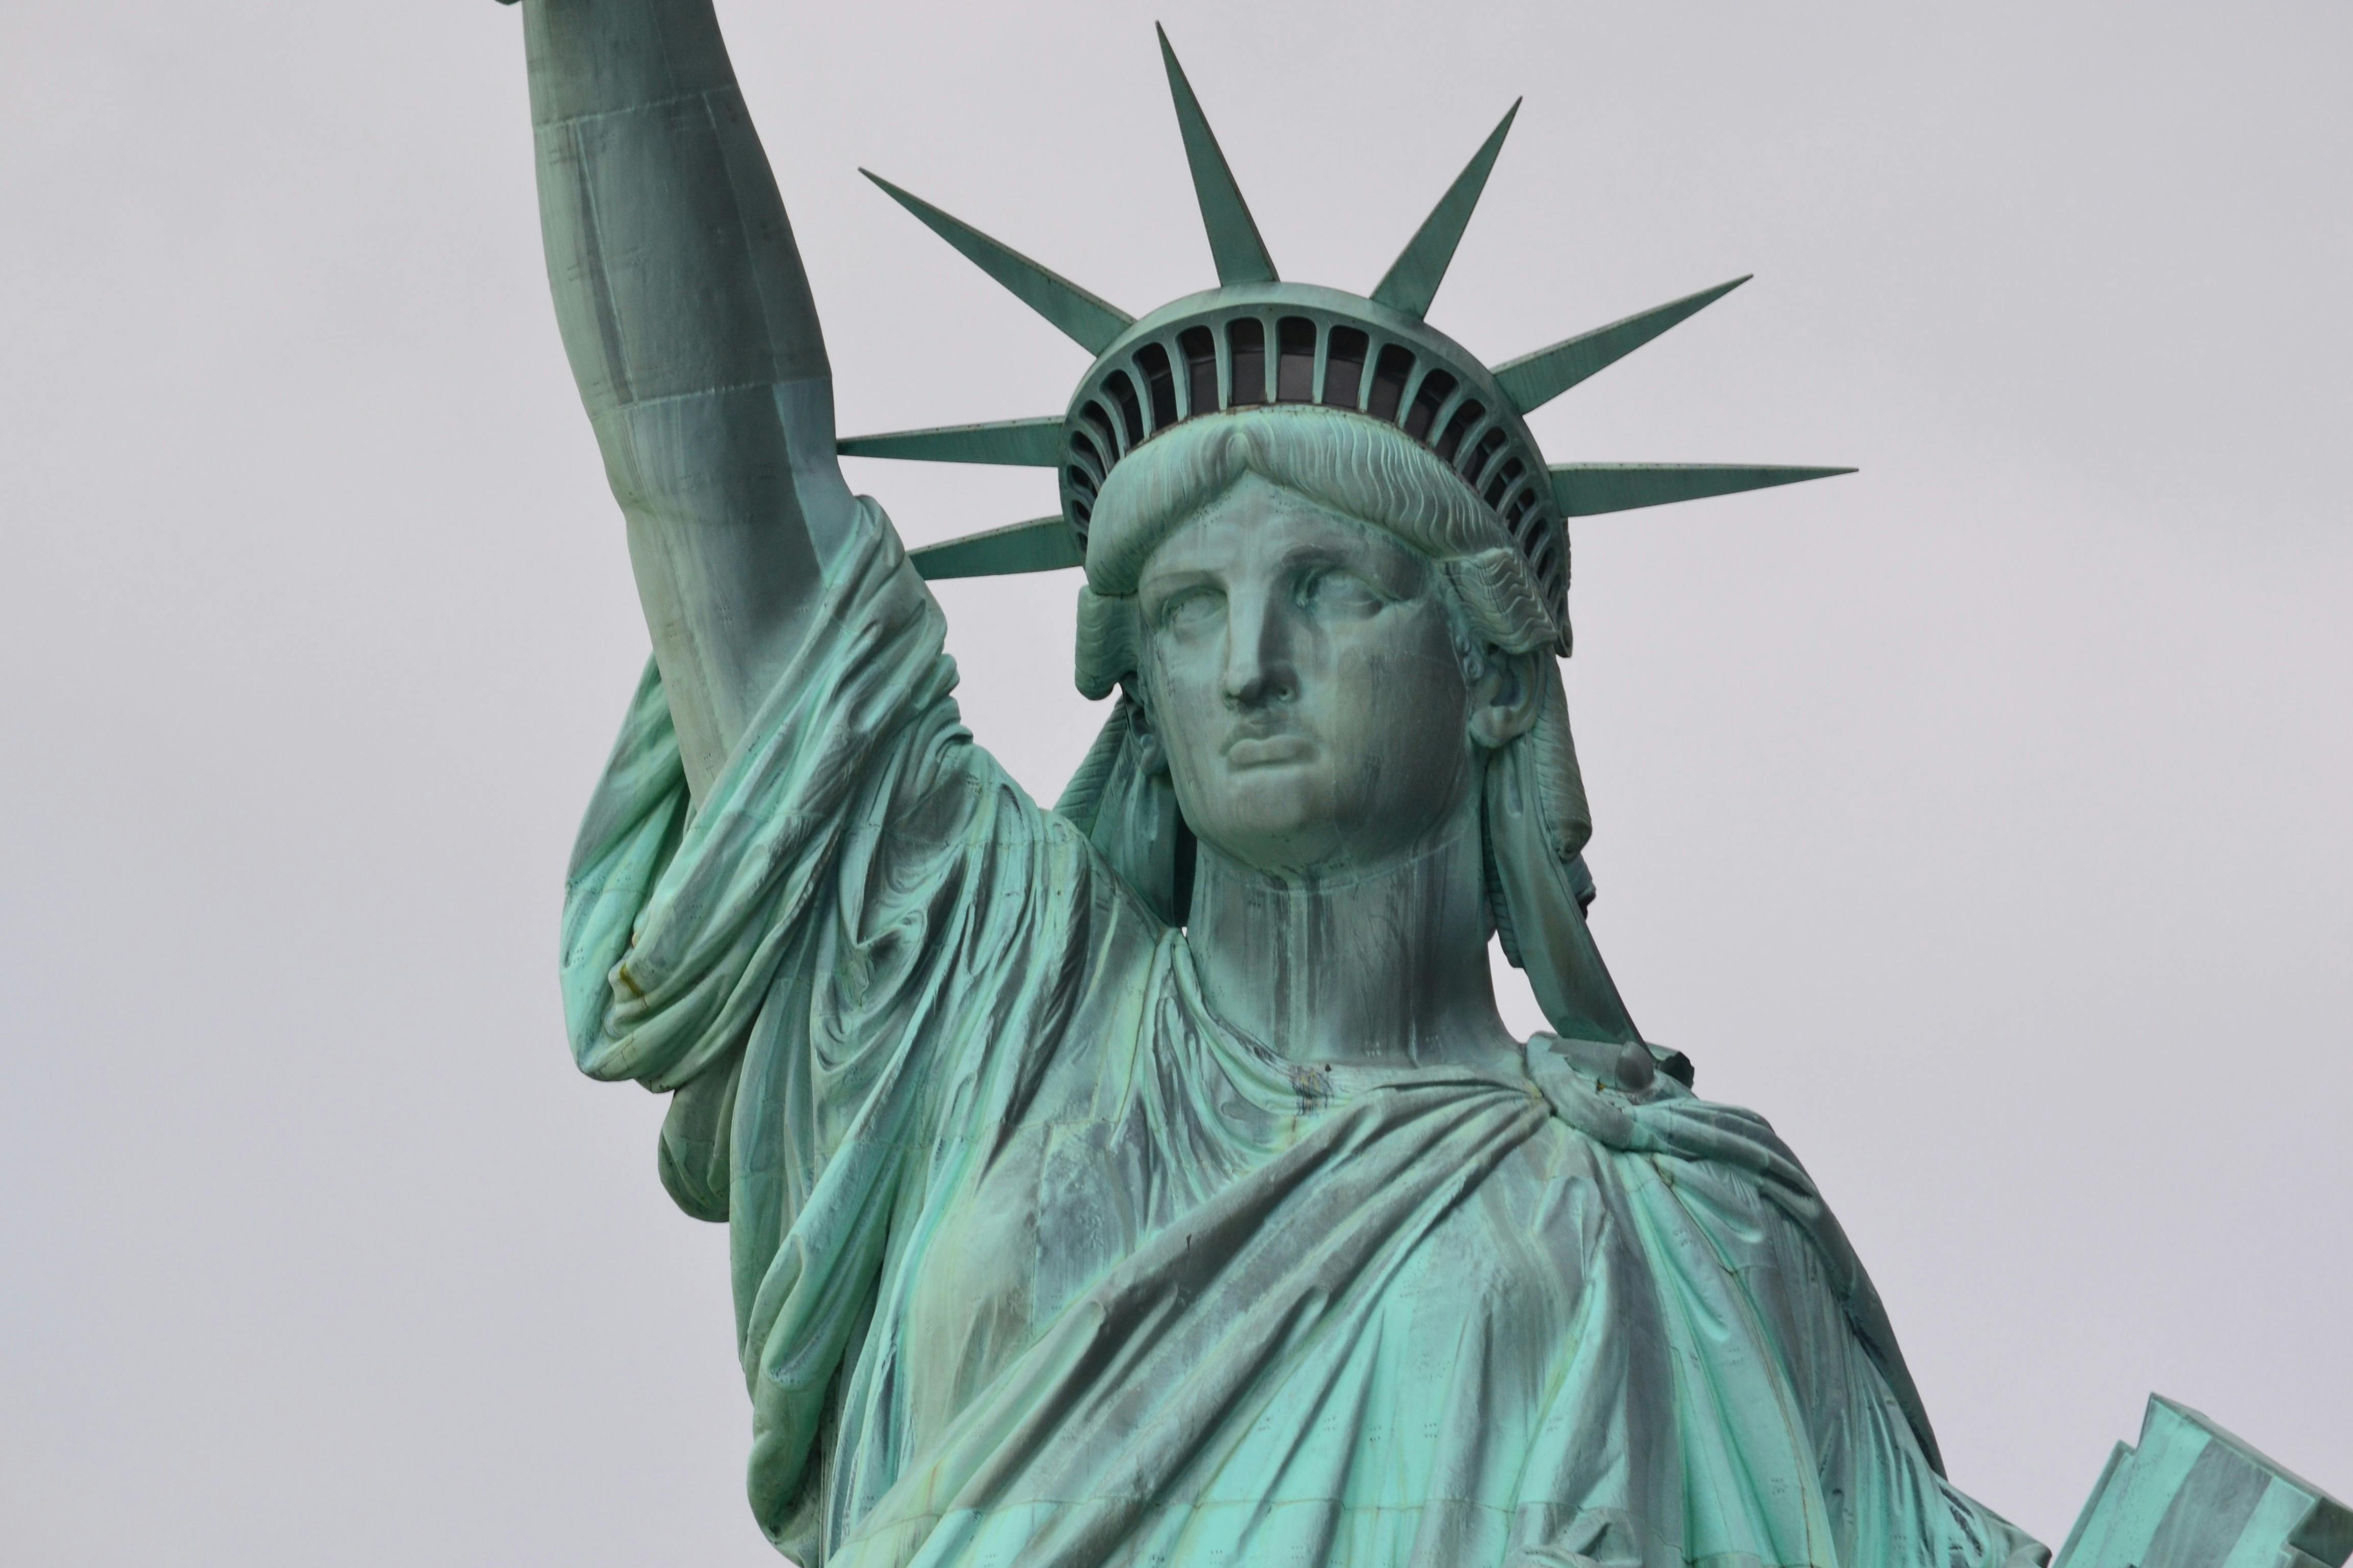
She is wearing flowing robes, and the seven rays of her spiked crown symbolize the seven seas and continents.

Slide 12
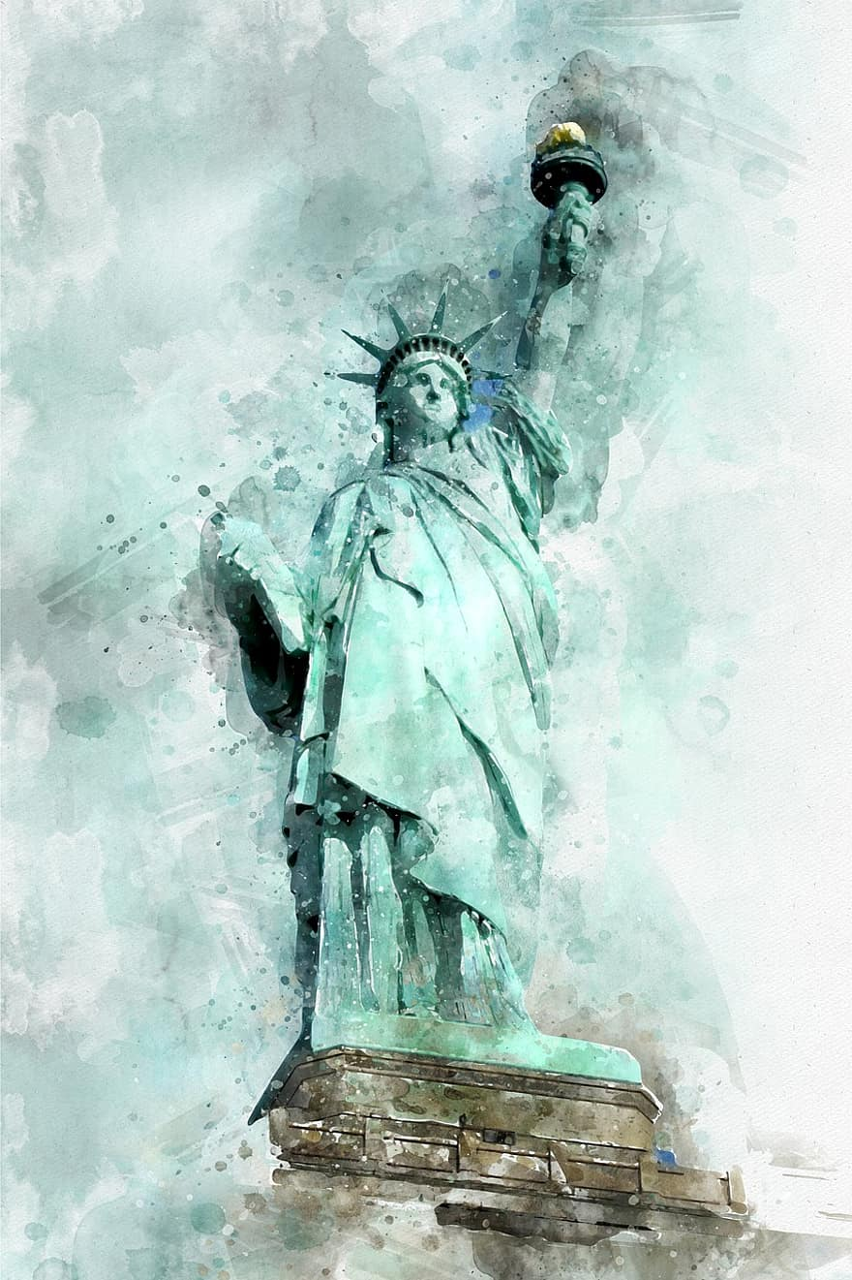
The most prominent words on the Statue of Liberty are from Emma Lazarus's poem, "The New Colossus," specifically the lines: "Give me your tired, your poor, Your huddled masses yearning to breathe free, The wretched refuse of your teeming shore." These words are inscribed on a plaque mounted inside the statue's pedestal.

